Slide 1

A Simple SIC Assembler

Slide 2
Basic assembler functions
Translating mnemonic operation codes to their machine language equivalents
Assigning machine addresses to symbolic labels
Source Program
Mnemonic Opcode
Symbol
Assembler
Object Code

Slide 3

Assembler directive
Assembler directives are pseudo instructions
They provide instructions to the assembler itself.
They are not translated into machine operation codes.
SIC assembler directive
START: Specify name and starting address
END: End of the source program, specify the first execution instruction
BYTE, WORD, RESB, RESW
End of record: a null char (00)
End of file : a zero-length record

Slide 4
Example program (Figure 2.1 pp. 45)

Slide 5
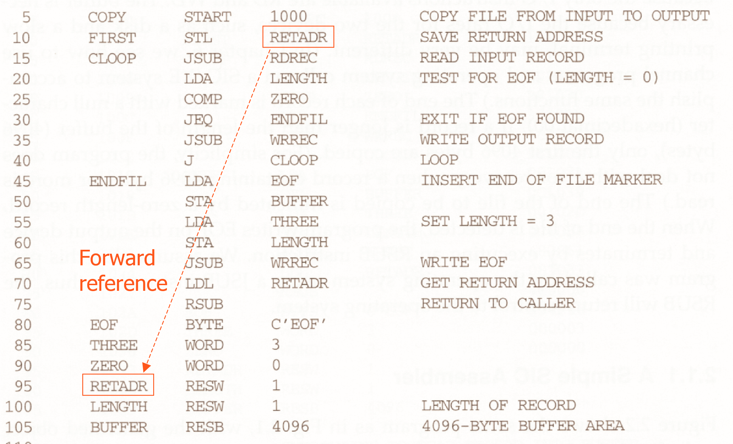

Slide 6
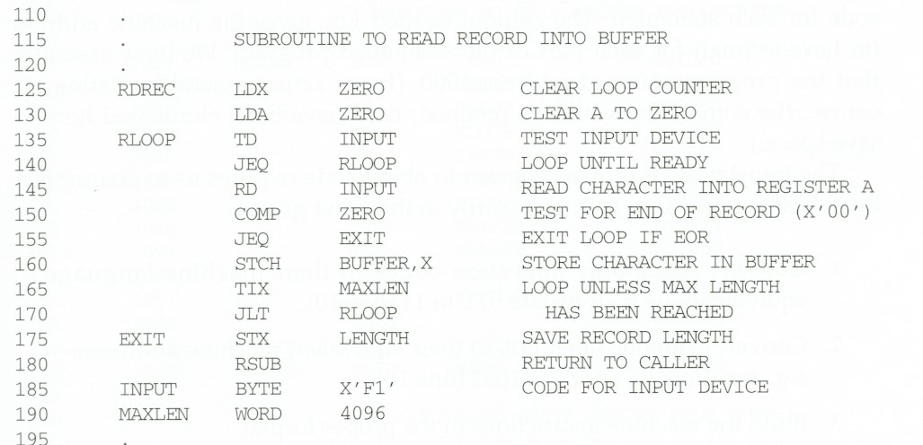

Slide 7
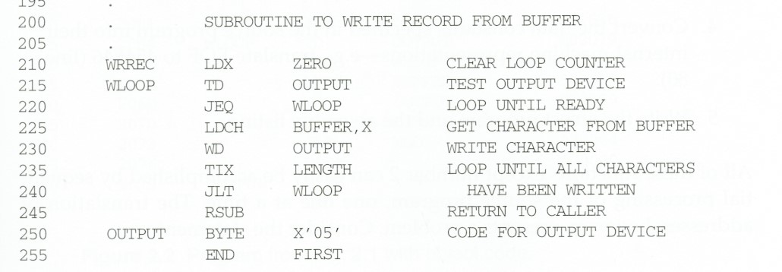

Slide 8
Assembler’s functions
Convert mnemonic operation codes to their machine language equivalents
Convert symbolic operands to their equivalent machine addresses
Decide the proper instruction format
Convert the data constants to internal machine representations
Write the object program and the assembly listing

Slide 9
Line no:15
JSUB=48
OPCODE x addr
0100 1000 0 0010 0000 0011 1001
Object Code:
4 8 2 0 3 9

Slide 10
Line no:20
LDA= 00
OPCODE x addr
0000 0000 0 0001 0000 0011 0110
Object Code:
0 0 1 0 3 6

Slide 11
Line no:75
RSUB=4C
OPCODE x addr
0100 1100 0 0000 0000 0000 0000
Object Code:
4 C 0 0 0 0

Slide 12
Line no: 80
102A EOF BYTE C’EOF’
!
Whenever ‘EOF’ mentioned within single
quote then the object code will be 454F46

Slide 13
Line no: 85
102D THREE WORD 3
Whenever ‘WORD’ is given as mnemonic opcode then the hexadecimal value of the operand will be the object code.
OBJECT CODE:000003

Slide 14
Line no:5,95,100,105&255
No Object Code for RESB,RESW,START and END
Note: No address generation for only START and END

Slide 15
Line no:160 294E STCH BUFFER, X
STCH= 54
OPCODE x addr
0101 0100 1 0001 0000 0011 1001
Object Code:
5 4 9 0 3 9

Slide 16
Line no:225 206A LDCH BUFFER, X
LDCH= 50
OPCODE x addr
0101 0000 1 0001 0000 0011 1001
Object Code:
5 0 9 0 3 9

Slide 17
Line no:185 & 250
In both the cases whatever is written in single quotes of the operand will be the Object code.
Object code: F1 and 05 respectively

Slide 18
THANK YOU

